Slide 1


Order Imbalance Based Trading Strategy
By Group 8, IEOR 4733
Members:
Harry Li, Meili Liang, Tiancheng Shu, Yuxin Wan, Yiran Wang, Yameng Zhang

Slide 2

Agenda
Model Introduction
Statistical Properties
Back Test
Conclusions & Prospect

Slide 3
Model Introduction

Slide 4
Introduction
From investigating the large amount of data, effective trading strategies can be developed to detect the market sentiment and attain substantial return.
One way to observe the market overall sentiment and transaction trend is to check the trade orders issued by both sides.
If there exist significant order imbalance in the market, intuitively we would consider that the imbalance may indicate a market trend. Thus, we can make trade decision based on order imbalance.
Based on this thought, we try to build and further modify the trading strategy model that includes order imbalance indicators.

Slide 5
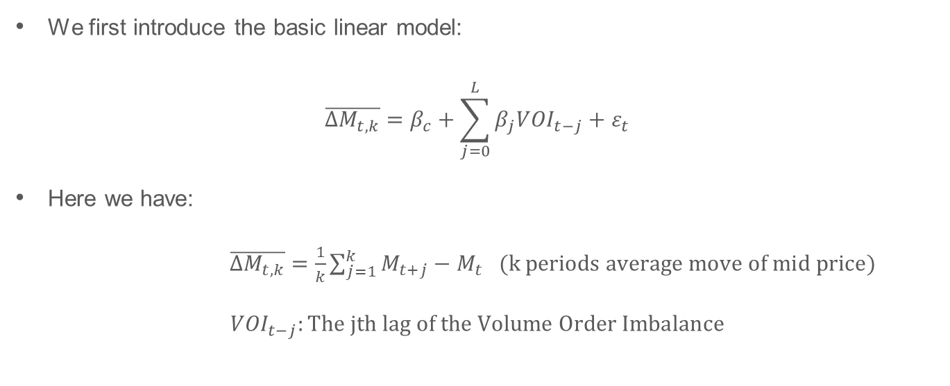
Basic Linear Model
We first introduce the basic linear model:
$$\overline{∆M_{t,k}}=β_{c}+\sum_{j=0}^{L}{β_{j}{VOI}_{t−j}}+ε_{t}$$
Here we have:
$\overline{∆M_{t,k}}=\frac{1}{k}\sum_{j=1}^{k}{M_{t+j}}−M_{t} (k periods average move of mid price)$
$${VOI}_{t−j}:The jth lag of the Volume Order Imbalance$$

Slide 6
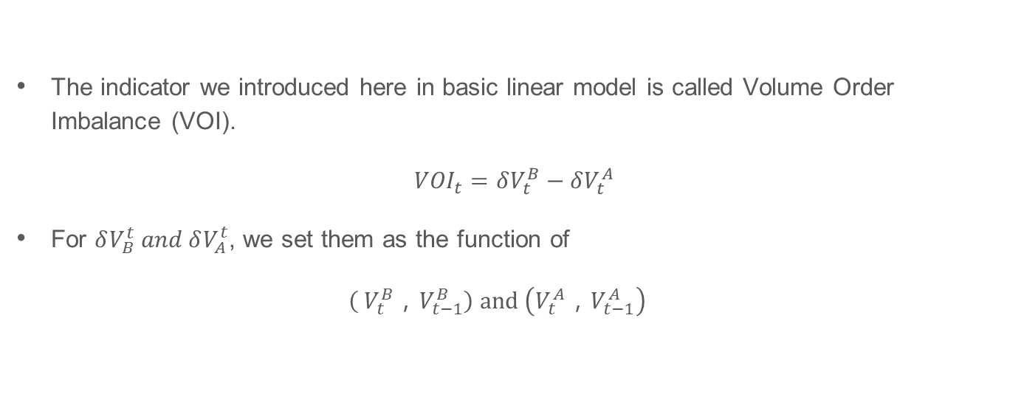
Volume Order Imbalance (VOI)
The indicator we introduced here in basic linear model is called Volume Order Imbalance (VOI).
$${VOI}_{t}=δV_{t}^{B}−δV_{t}^{A}$$
For $δV_{B}^{t} and δV_{A}^{t}$, we set them as the function of
$\left( V_{t}^{B}，V_{t−1}^{B}\right) and \left(V_{t}^{A}，V_{t−1}^{A}\right)$

Slide 7
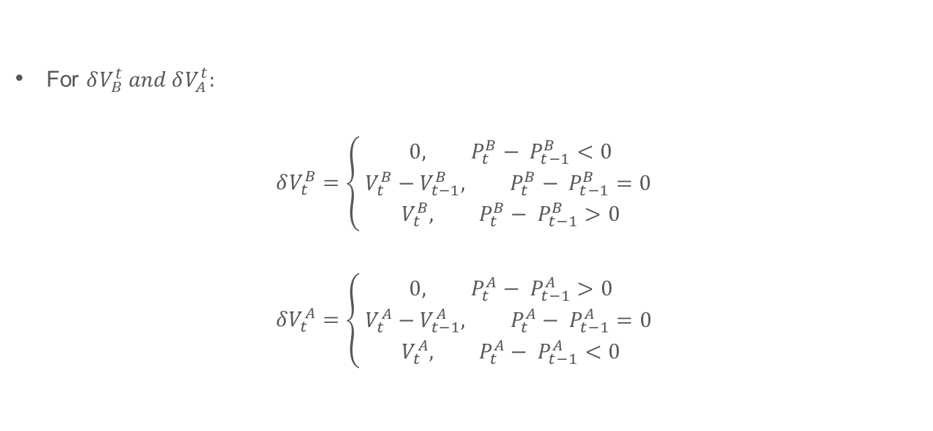
Volume Order Imbalance (VOI)
For $δV_{B}^{t} and δV_{A}^{t}:$
$$δV_{t}^{B}=\left\{\begin{aligned}0, P_{t}^{B}− P_{t−1}^{B}<0 \\ V_{t}^{B}−V_{t−1}^{B}, P_{t}^{B}− P_{t−1}^{B}=0 \\ V_{t}^{B}, P_{t}^{B}− P_{t−1}^{B}>0\end{aligned}\right.$$
$$δV_{t}^{A}=\left\{\begin{aligned}0, P_{t}^{A}− P_{t−1}^{A}>0 \\ V_{t}^{A}−V_{t−1}^{A}, P_{t}^{A}− P_{t−1}^{A}=0 \\ V_{t}^{A}, P_{t}^{A}− P_{t−1}^{A}<0\end{aligned}\right.$$

Slide 8
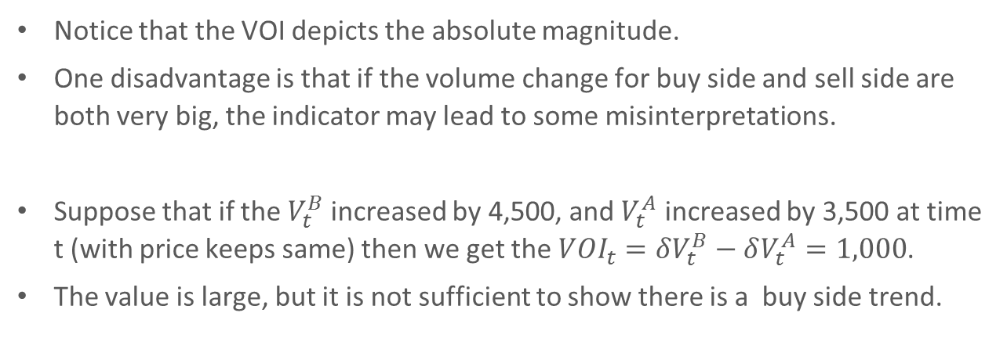
Volume Order Imbalance (VOI)
Notice that the VOI depicts the absolute magnitude.
One disadvantage is that if the volume change for buy side and sell side are both very big, the indicator may lead to some misinterpretations.
Suppose that if the $V_{t}^{B}$ increased by 4,500, and $V_{t}^{A}$ increased by 3,500 at time t (with price keeps same) then we get the ${VOI}_{t}=δV_{t}^{B}−δV_{t}^{A}=1,000$.
The value is large, but it is not sufficient to show there is a buy side trend.

Slide 9
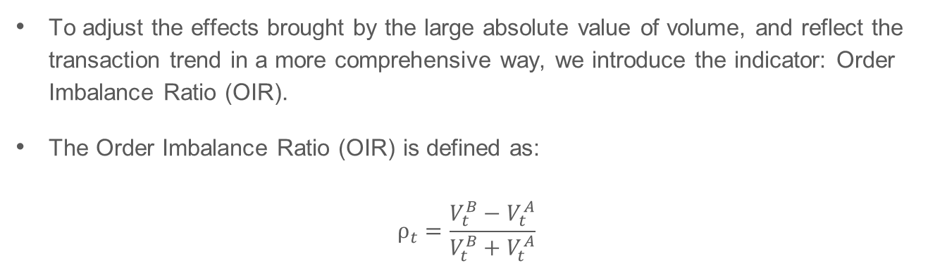
Order Imbalance Ratio (OIR)
To adjust the effects brought by the large absolute value of volume, and reflect the transaction trend in a more comprehensive way, we introduce the indicator: Order Imbalance Ratio (OIR).
The Order Imbalance Ratio (OIR) is defined as:
$$ρ_{t}=\frac{V_{t}^{B}−V_{t}^{A}}{V_{t}^{B}+V_{t}^{A}}$$

Slide 10
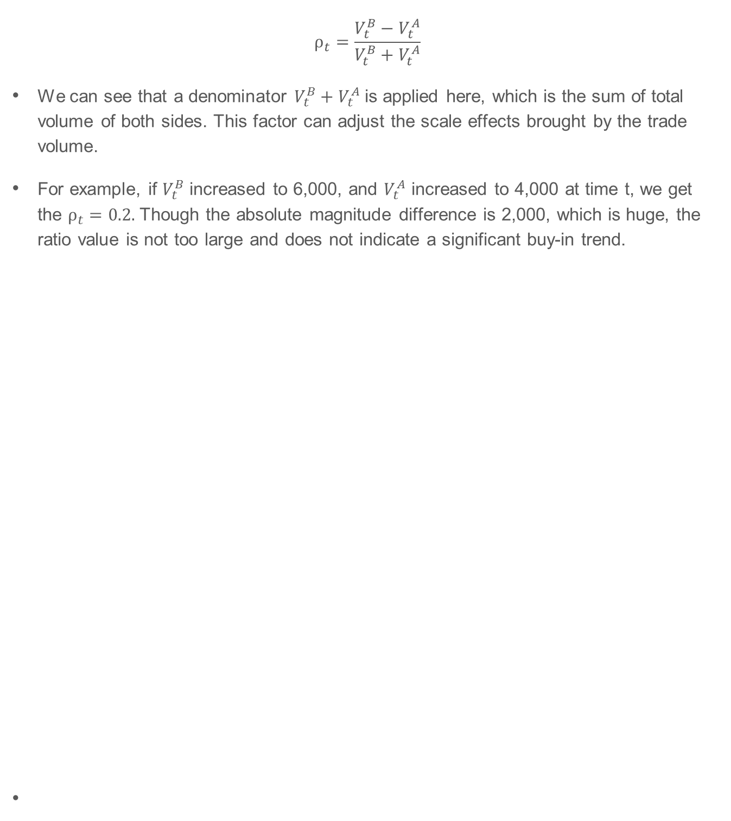
Order Imbalance Ratio (OIR)
$$ρ_{t}=\frac{V_{t}^{B}−V_{t}^{A}}{V_{t}^{B}+V_{t}^{A}}$$
We can see that a denominator $V_{t}^{B}+V_{t}^{A}$is applied here, which is the sum of total volume of both sides. This factor can adjust the scale effects brought by the trade volume.
For example, if $V_{t}^{B}$ increased to 6,000, and $V_{t}^{A}$ increased to 4,000 at time t, we get the $ρ_{t}=0.2.$Though the absolute magnitude difference is 2,000, which is huge, the ratio value is not too large and does not indicate a significant buy-in trend.

Slide 11
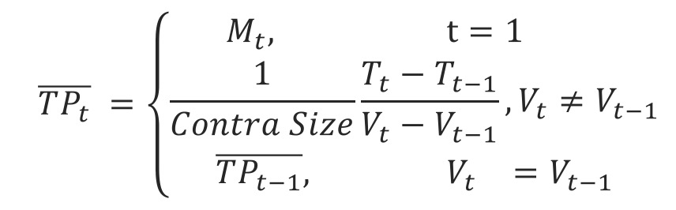
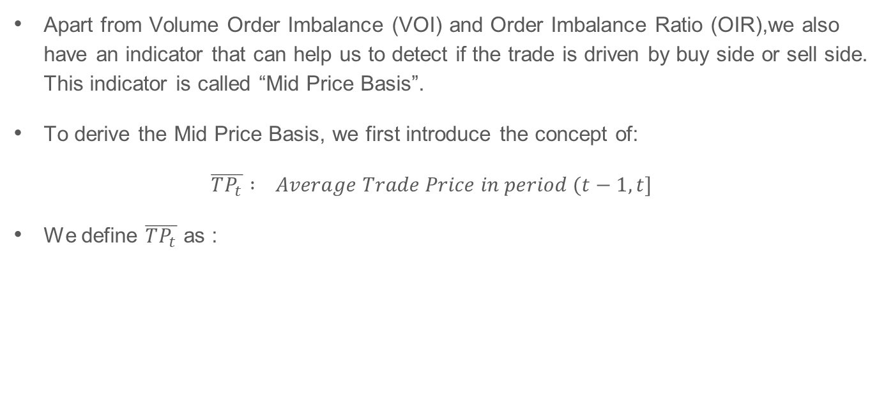
Mid Price Basis (MPB)
Apart from Volume Order Imbalance (VOI) and Order Imbalance Ratio (OIR),we also have an indicator that can help us to detect if the trade is driven by buy side or sell side. This indicator is called “Mid Price Basis”.
To derive the Mid Price Basis, we first introduce the concept of:
$\overline{TP_{t}} : Average Trade Price in period (t−1,t]$
We define $\overline{TP_{t}}$ as :

Slide 12
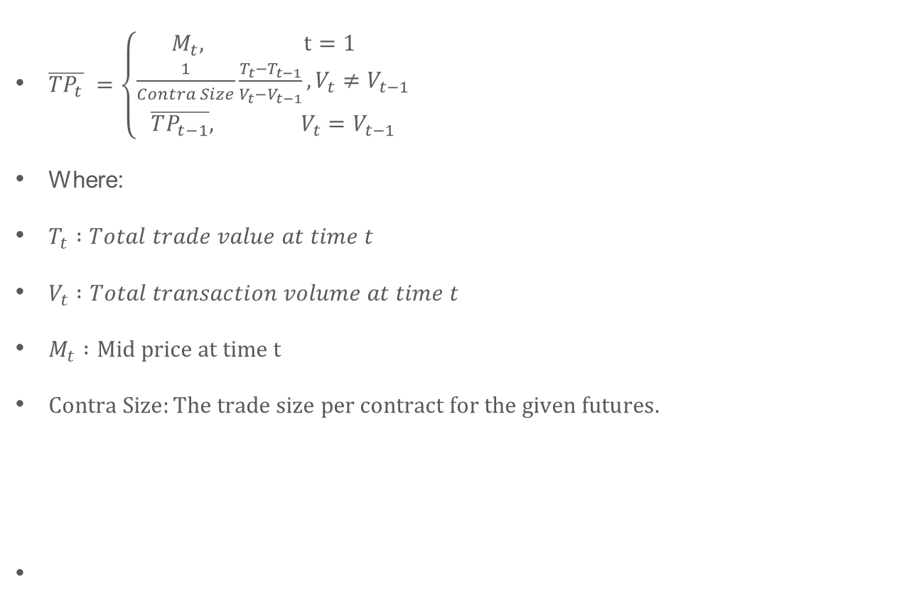
Mid Price Basis (MPB)
$\overline{TP_{t}} =\left\{\begin{aligned}M_{t}, & t=1 \\ \frac{1}{Contra Size}\frac{T_{t}−T_{t−1}}{V_{t}−V_{t−1}}, V_{t}≠V_{t−1} \\ \overline{TP_{t−1}}, & V_{t}=V_{t−1}\end{aligned}\right.$
Where:
$T_{t} :Total trade value at time t$
$V_{t} :Total transaction volume at time t$
$M_{t} :Mid price at time t$
$Contra Size:The trade size per contract for the given futures.$

Slide 13
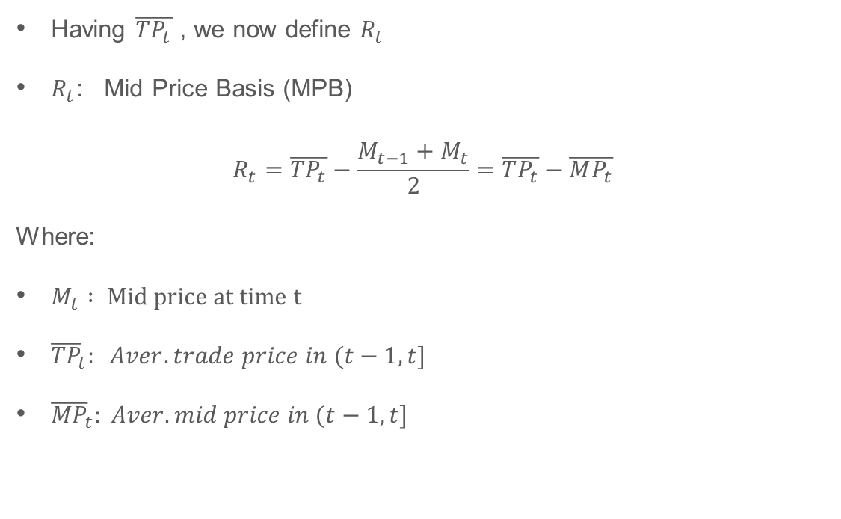
Mid Price Basis (MPB)
Having $\overline{TP_{t}}$ , we now define $R_{t}$
$R_{t}$: Mid Price Basis (MPB)
$$R_{t}=\overline{TP_{t}}−\frac{M_{t−1}+M_{t}}{2}=\overline{TP_{t}}−\overline{MP_{t}}$$
Where:
$M_{t} : Mid price at time t$
${\overline{TP}}_{t}: Aver. trade price in (t−1,t]$
${\overline{MP}}_{t}: Aver. mid price in (t−1,t]$

Slide 14
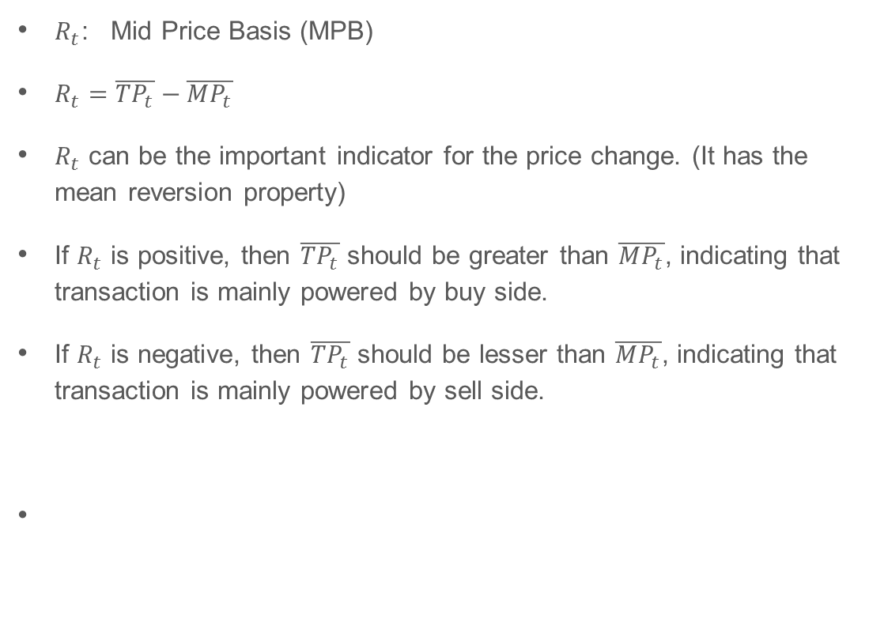
Mid Price Basis (MPB)
$R_{t}$: Mid Price Basis (MPB)
$R_{t}=\overline{TP_{t}}−\overline{MP_{t}}$
$R_{t}$ can be the important indicator for the price change. (It has the mean reversion property)
If $R_{t}$ is positive, then $\overline{TP_{t}}$ should be greater than $\overline{MP_{t}}$, indicating that transaction is mainly powered by buy side.
If $R_{t}$ is negative, then $\overline{TP_{t}}$ should be lesser than $\overline{MP_{t}}$, indicating that transaction is mainly powered by sell side.

Slide 15
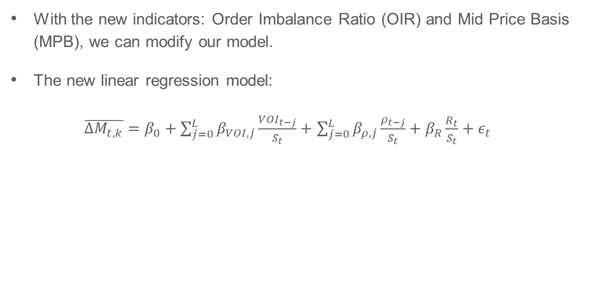
Improved Model
With the new indicators: Order Imbalance Ratio (OIR) and Mid Price Basis (MPB), we can modify our model.
The new linear regression model:
$\overline{∆M_{t,k}}=β_{0}+\sum_{j=0}^{L}{β_{VOI,j}\frac{{VOI}_{t−j}}{S_{t}}}+$ $\sum_{j=0}^{L}{β_{ρ,j}\frac{ρ_{t−j}}{S_{t}}}+β_{R}\frac{R_{t}}{S_{t}}+ε_{t}$

Slide 16
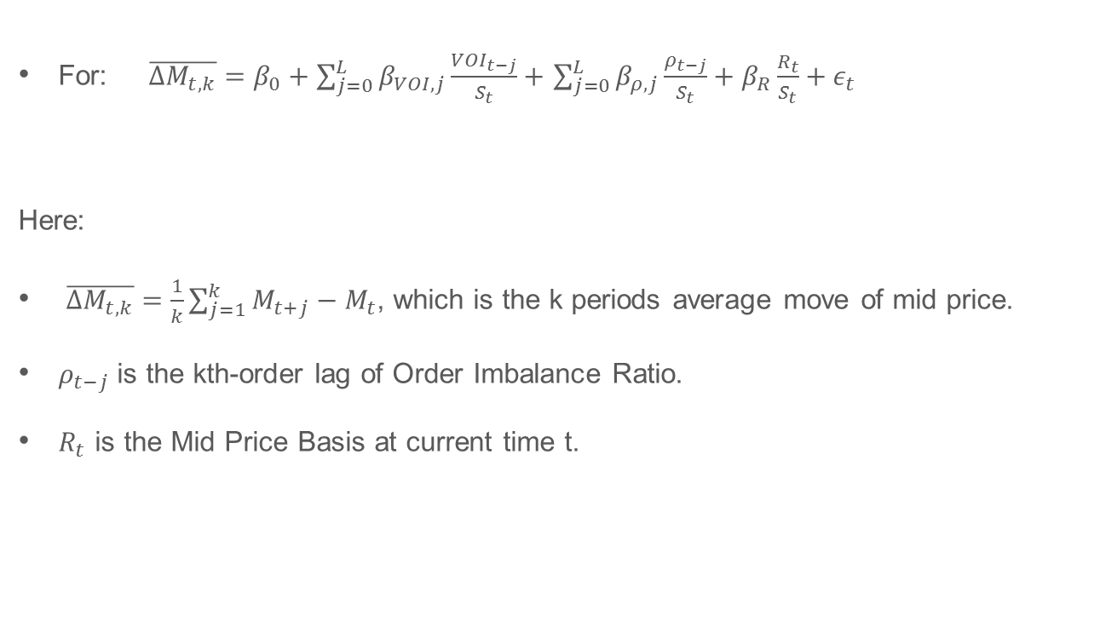
Improved Model
For: $\overline{∆M_{t,k}}=β_{0}+\sum_{j=0}^{L}{β_{VOI,j}\frac{{VOI}_{t−j}}{S_{t}}}+$ $\sum_{j=0}^{L}{β_{ρ,j}\frac{ρ_{t−j}}{S_{t}}}+β_{R}\frac{R_{t}}{S_{t}}+ε_{t}$
Here:
$\overline{∆M_{t,k}}=\frac{1}{k}\sum_{j=1}^{k}{M_{t+j}}−M_{t}$, which is the k periods average move of mid price.
$ρ_{t−j}$ is the kth-order lag of Order Imbalance Ratio.
$R_{t}$ is the Mid Price Basis at current time t.

Slide 17
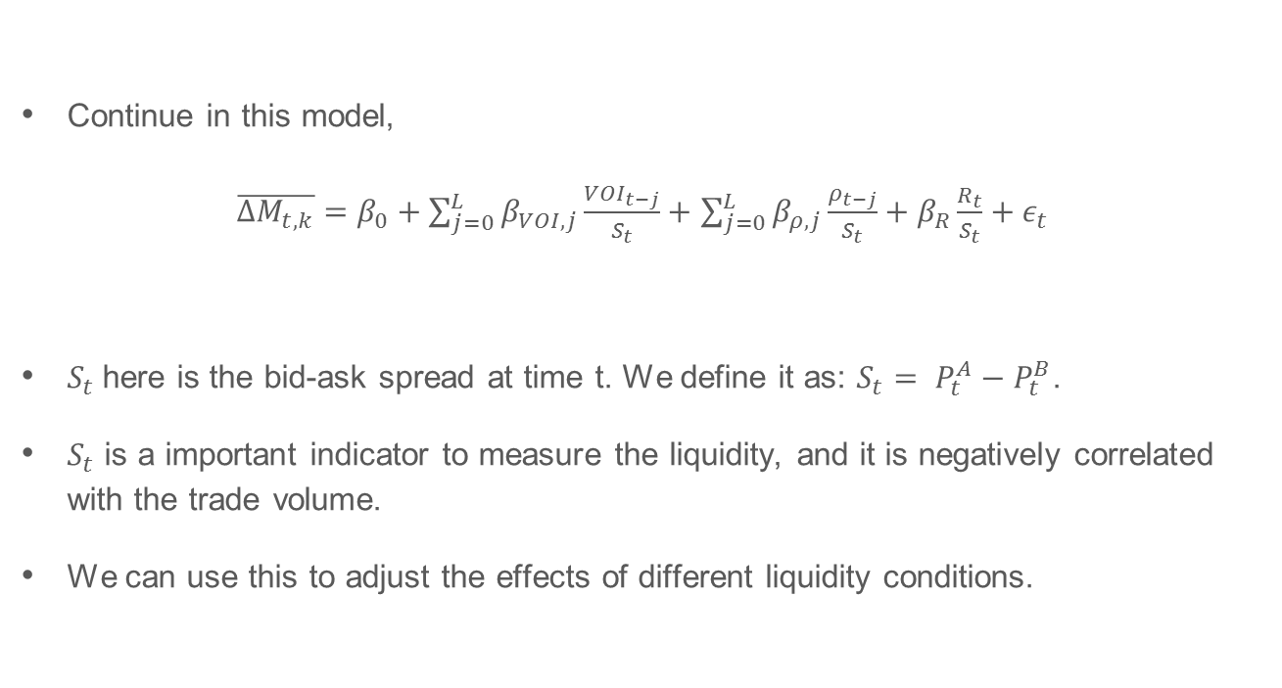
Improved Model
Continue in this model,
$\overline{∆M_{t,k}}=β_{0}+\sum_{j=0}^{L}{β_{VOI,j}\frac{{VOI}_{t−j}}{S_{t}}}+$ $\sum_{j=0}^{L}{β_{ρ,j}\frac{ρ_{t−j}}{S_{t}}}+β_{R}\frac{R_{t}}{S_{t}}+ε_{t}$
$S_{t}$here is the bid-ask spread at time t. We define it as: $S_{t}= P_{t}^{A}−P_{t}^{B}$.
$S_{t}$ is a important indicator to measure the liquidity, and it is negatively correlated with the trade volume.
We can use this to adjust the effects of different liquidity conditions.

Slide 18
Indicators Overview
Here, we briefly take a quick look to the indicators we investigate.
Volume Order Imbalance (VOI)
Order Imbalance Ratio (OIR)
Mid Price Basis (MPB)

Slide 19
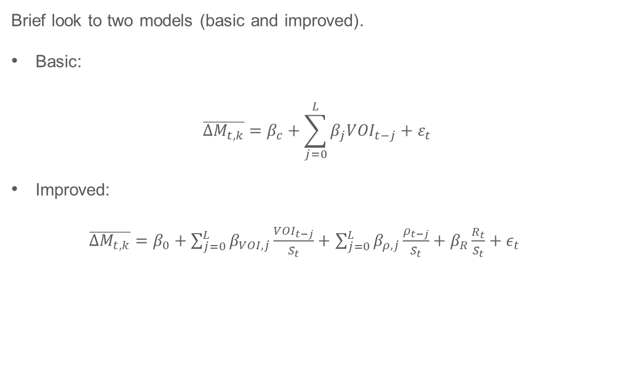
Models Summary
Brief look to two models (basic and improved).
Basic:
$$\overline{∆M_{t,k}}=β_{c}+\sum_{j=0}^{L}{β_{j}{VOI}_{t−j}}+ε_{t}$$
Improved:
$\overline{∆M_{t,k}}=β_{0}+\sum_{j=0}^{L}{β_{VOI,j}\frac{{VOI}_{t−j}}{S_{t}}}+$ $\sum_{j=0}^{L}{β_{ρ,j}\frac{ρ_{t−j}}{S_{t}}}+β_{R}\frac{R_{t}}{S_{t}}+ε_{t}$

Slide 20
Statistical Properties

Slide 21
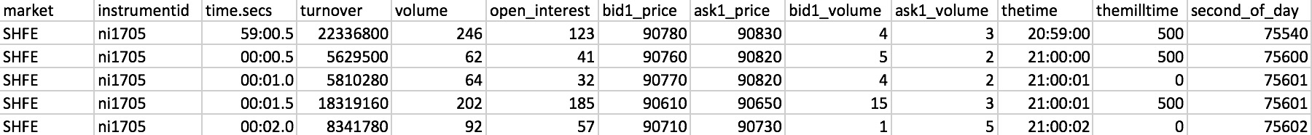
Data
Data Source: Shanghai Futures Exchange
Date Range: 2017.03.01-2017.03.31
Instrument Type: Nickel, Rubber, Rebar,Copper, Aluminum
Data Time Interval: 500 milliseconds. That is, time t + 1 is 500 ms after time t.
Snapshot of the Data:
Second of Day:
> as.numeric(substr(a$thetime,1,2))*3600+as.numeric(substr(a$thetime,4,5))*60+as.numeric(substr(a$thetime,7,8))
Sample Data: ‘Ni1705_20170301’

Slide 22
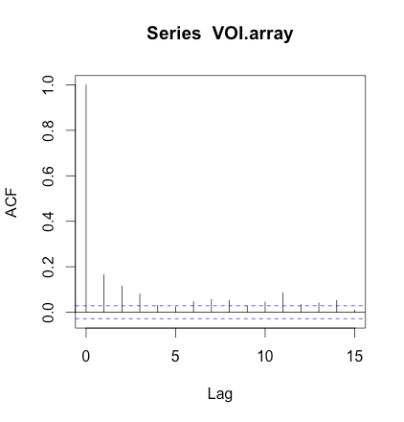
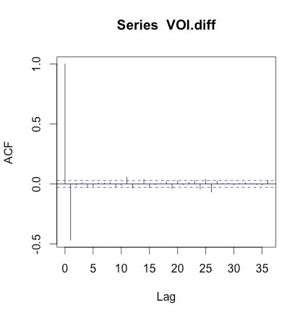
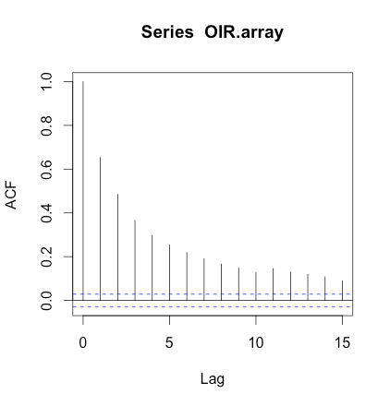
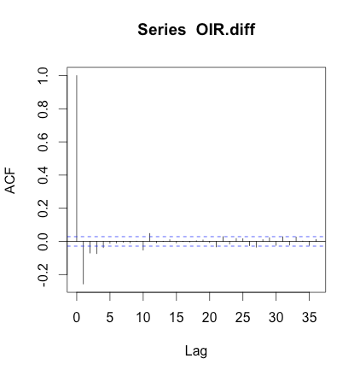
Indicator Properties
For VOI:
The autocorrelations of VOI is significant and positive for the first 5 lags
First difference is a large negative
For OIR:
The autocorrelations of OIR is significant and positive for the first 5 lags
First difference is a large negative
The graphs they share the same signs and similar magnitudes with the autocorrelation of VOI

Slide 23
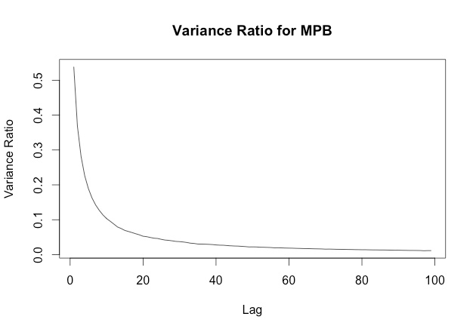
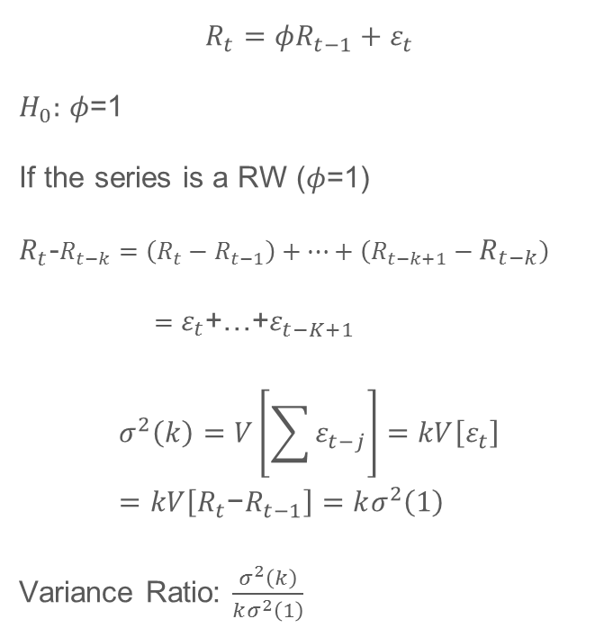
$$R_{t}={φR}_{t−1}+ε_{t}$$
$H_{0}:$ $φ$=1
If the series is a RW ($φ$=1)
$R_{t}$-$R_{t−k}=\left(R_{t}−R_{t−1}\right)+…+\left(R_{t−k+1}−R_{t−k}\right)$
$=ε_{t}$+…+$ε_{t−K+1}$
$$σ^{2}\left(k\right)=V\left[\sum{ε_{t−j}}\right]=kV\left[ε_{t}\right]=kV\left[R_{t}\text{−}R_{t−1}\right]=kσ^{2}\left(1\right)$$
Variance Ratio: $\frac{σ^{2}\left(k\right)}{kσ^{2}\left(1\right)}$
Indicator Properties

Slide 24
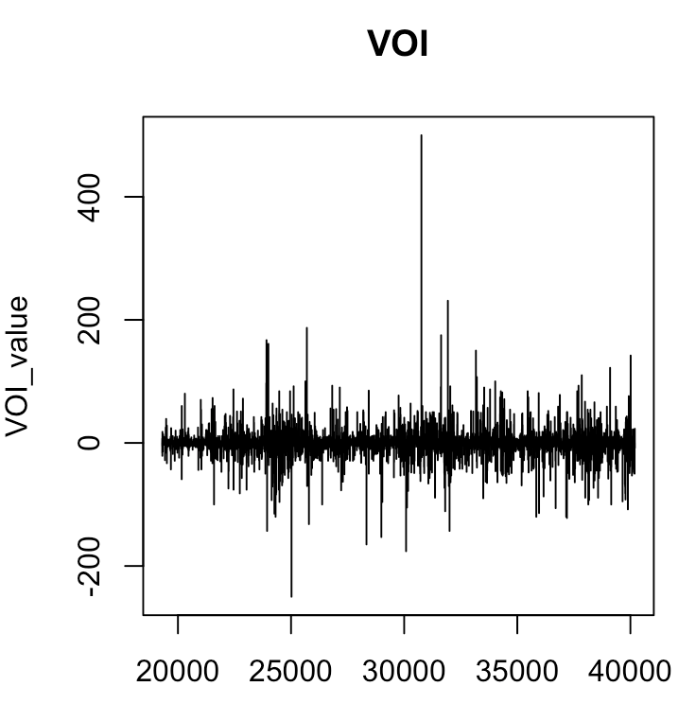
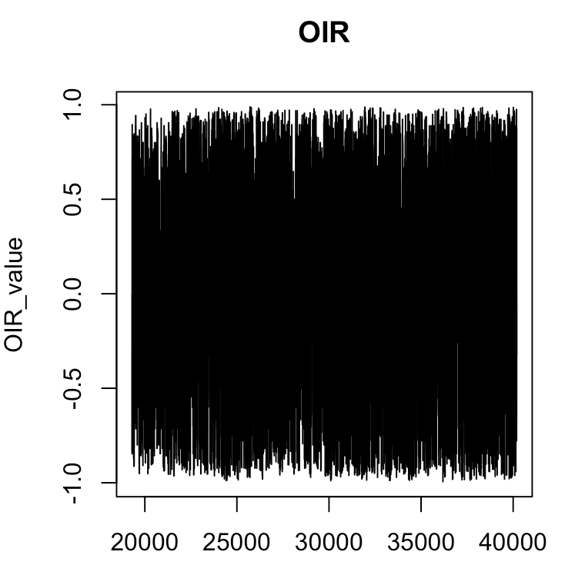
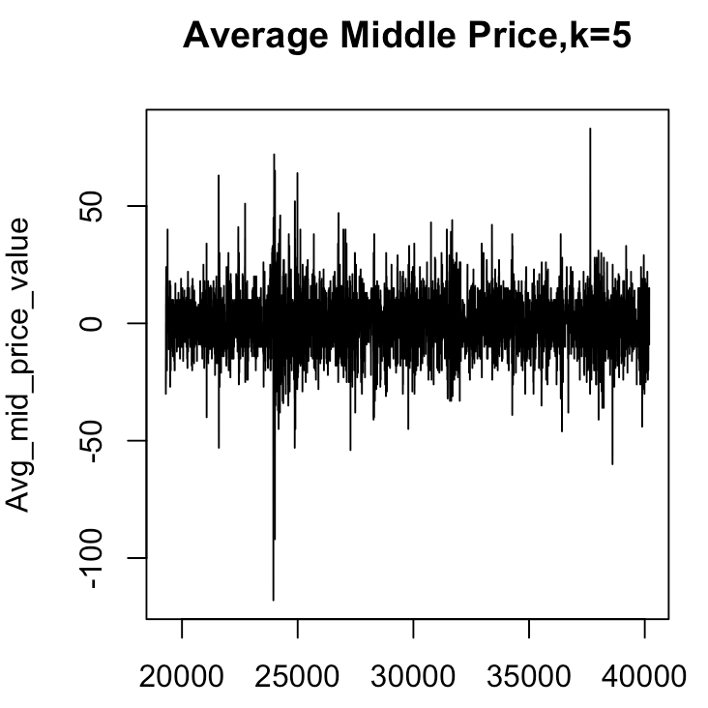
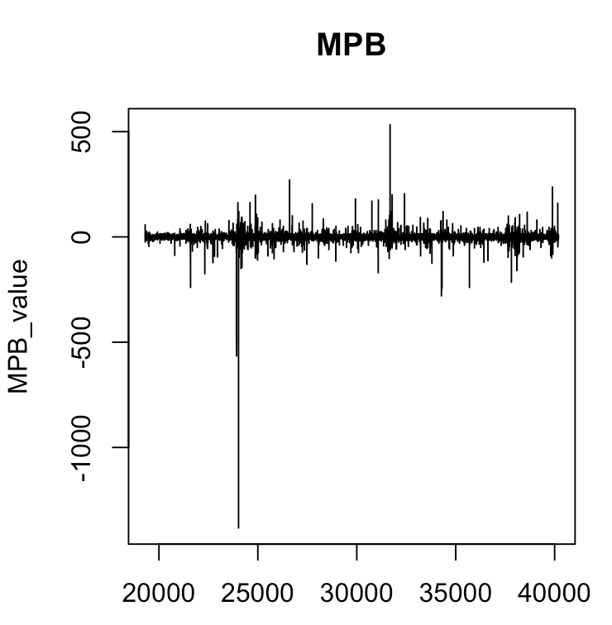
Stationary Test
Fluctuation range of VOI and MPB vary in different time segments
Heteroscedasticity
Fluctuation range of OIR and Average Middle Price is stable
Homoscedasticity
Value Change Along the time

Slide 25
Stationary Test
ADF & KPSS Test Result:
ADF Test (Augmented Dickey Fuller Test)
null hypothesis: there is a unit root
Alternate hypothesis: the time series is stationary
KPSS Test(Kwiatkowski- Phillips - Schmidt - Shin Test)
null hypothesis: the data is stationary
Alternate hypothesis: the data is not stationary
 | ADF( t stat) | KPSS
VOI | -25.607 | 0.10467
OIR | -21.938 | 0.20226
MPB | -25.751 | 0.20301
AVG Middle Price, k = 5 | -26.358 | 0.080287
ADF Test |  |  |  |  | KPSS Test
 | Mt | VOI | OIR | MPB |  | Mt | VOI | OIR | MPB
Reject | 100% | 100% | 100% | 100% | Reject | 22% | 0% | 0% | 5%
Fail to Reject | 0% | 0% | 0% | 0% | Fail to Reject | 78% | 100% | 100% | 95%

Slide 26
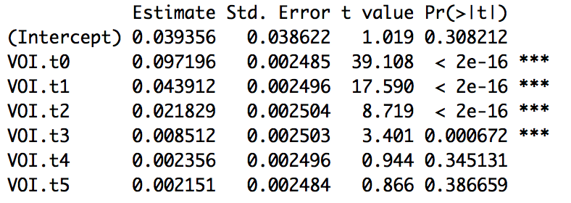
Analysis of Regression Result on Trade Model
Result based on trade data on Ni1705 contract on March 1st, 2017
Basic Regression Model Result
Instantaneous VOI and VOI up to lag 3 are significant
R^2 is 4.618%
Consistent with the result on NASDAQ equity data in our reference paper
Notes:
instantaneous and lagged order imbalance are signicantly

Slide 27
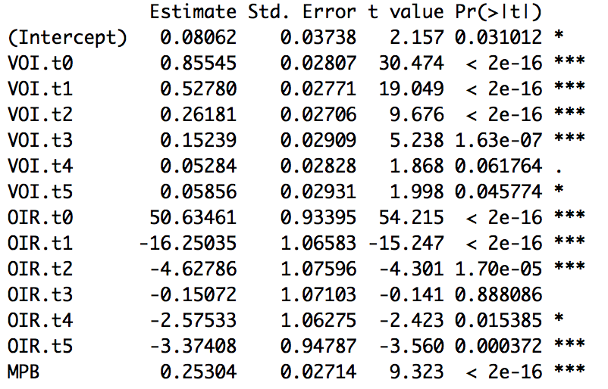
Analysis of Regression Result on Trade Model
Result based on trade data on Ni1705 contract on March 1st, 2017
Improved Regression Model Result
R^2 is 10.9%

Slide 28
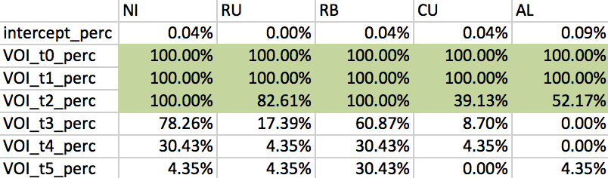
Analysis of Regression Result on Trade Model
Basic Regression Model Result based on one-month( 2017/03/01 - 2017/03/31) trade data of five different metals
Nickel, Rubber, Rebar, Copper, Aluminum
Percentage when coefficients of variable positive and significant

Slide 29
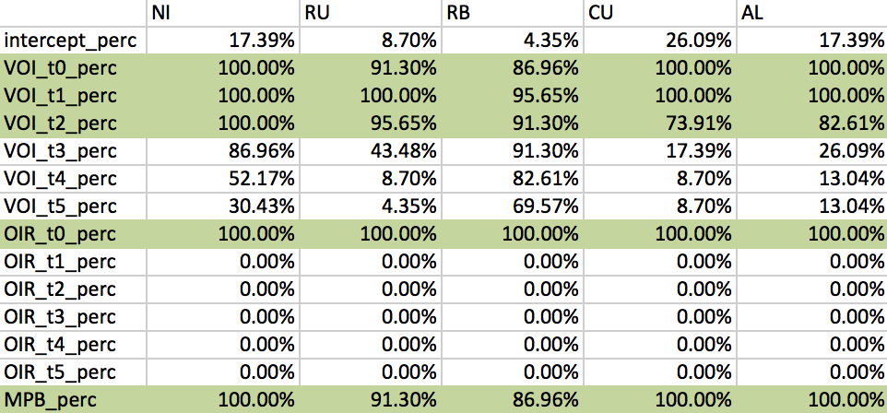
Analysis of Regression Result on Trade Model
Improved Regression Model Result based on one-month( 2017/03/01 - 2017/03/31) trade data of five different metals
Nickel, Rubber, Rebar,Copper, Aluminum
Percentage when coefficients of variable are positive and significant

Slide 30
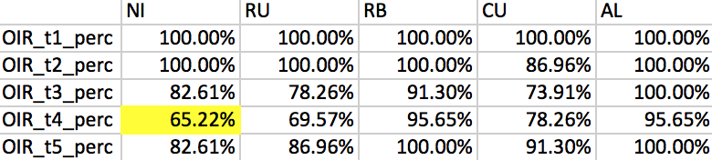
Analysis of Regression Result on Trade Model
OIR_t1 to OIR_t5
Percentage when coefficients of variable are negative and significant

Slide 31
Empirical Evidence
Instantaneous VOI and VOI with lag 1 to lag 3 are significant for all metals
positive relationship
OIR with lag 1 to lag 5 are significant for all metals
instantaneous OIR indicates positive relationship
OIR with lag 1 to lag 5 indicates negative relationship
Coefficients of MPB for all metals are positive and significant
R^2 of the improved model is greater than the basic model
better model
can generate more profit
Use both the basic and improved model as trade models
Compare performance

Slide 32
Back Test

Slide 33
Assumptions
We can always sell at bid and buy at ask
There is no time lag from getting the data and placing the order
Cost= 0.025%
The maximum position is ±1 contract, and we can only trade whole contracts

Slide 34
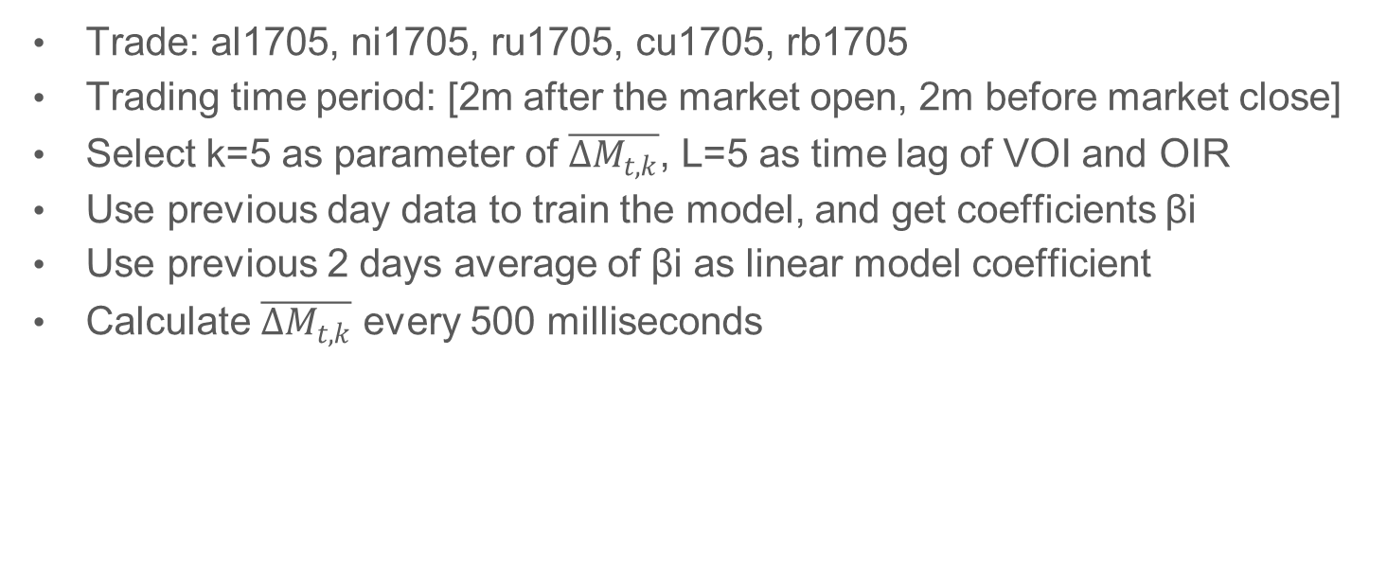
Trading Strategy
Trade: al1705, ni1705, ru1705, cu1705, rb1705
Trading time period: [2m after the market open, 2m before market close]
Select k=5 as parameter of $\overline{∆M_{t,k}}$, L=5 as time lag of VOI and OIR
Use previous day data to train the model, and get coefficients βi
Use previous 2 days average of βi as linear model coefficient
Calculate $\overline{∆M_{t,k}}$ every 500 milliseconds
T-2
T-1
T0

Slide 35
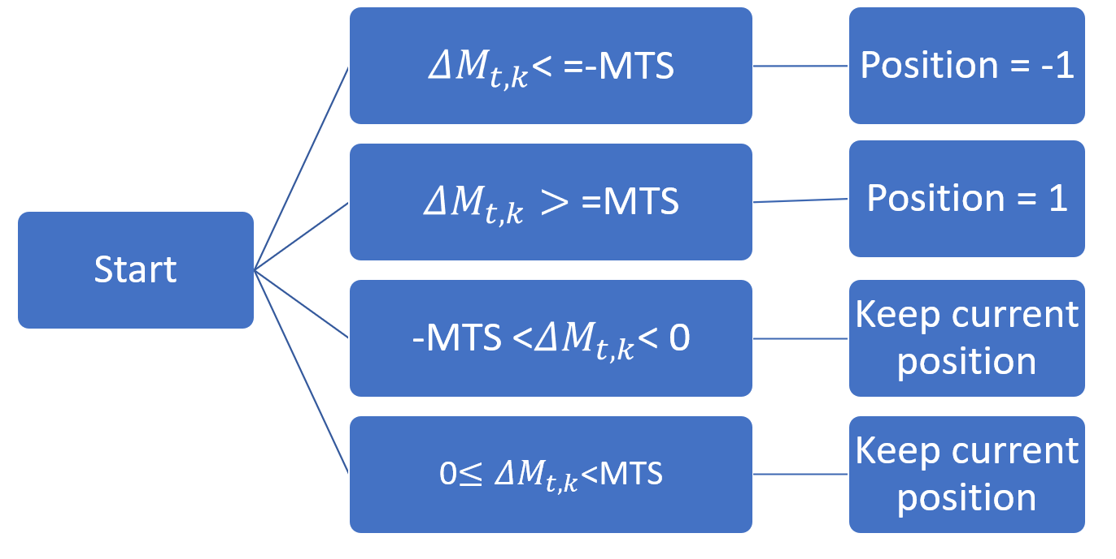
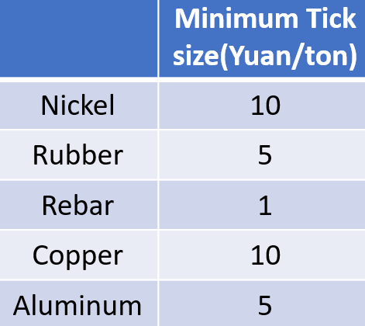
Trading Strategy
When △M is smaller than negative minimum tick size, adjust our position to -1.
When △M is larger than minimum tick size, adjust our position to 1
Otherwise keep current position

Slide 36
Summary of Backtest
Improved model has better performance
Nickel and Rubber have better performance
Daily average number of transactions varies from contract to contract
Daily average profit of Rebar becomes positive after switching to improved model.

Slide 37
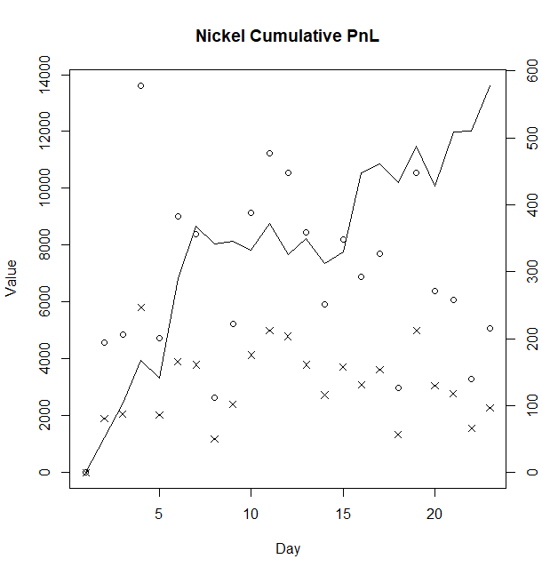
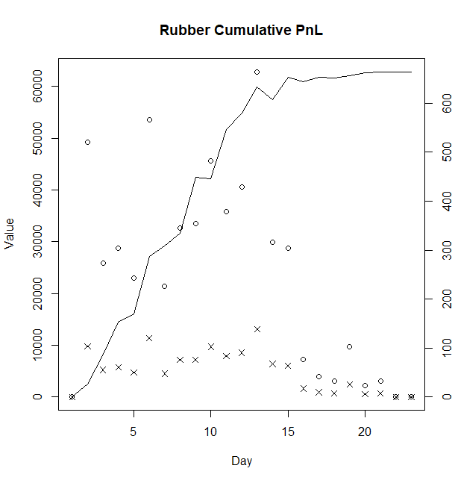
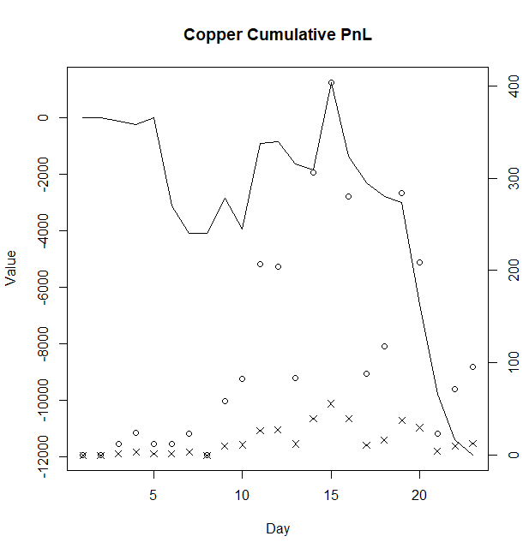
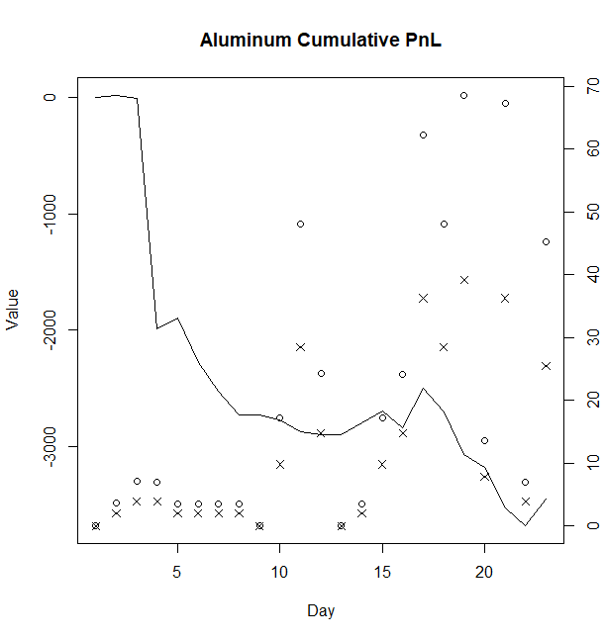
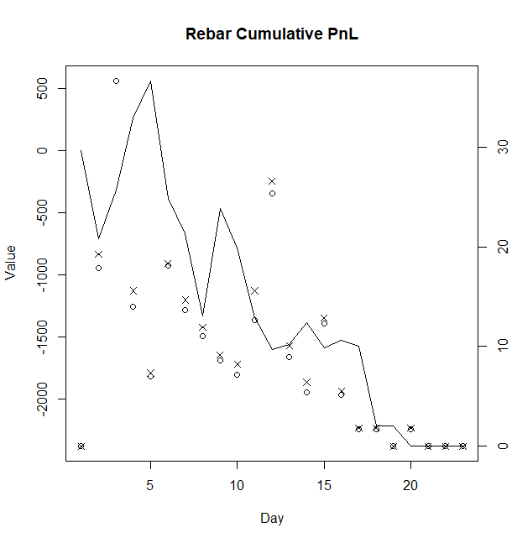
Result of Basic model
○:Trading Cost
×:Number of Trade
-: cumulative profit

Slide 38
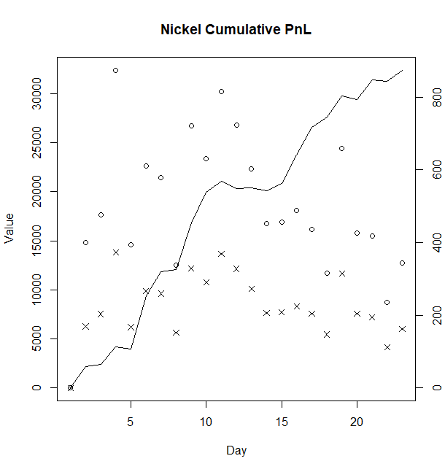
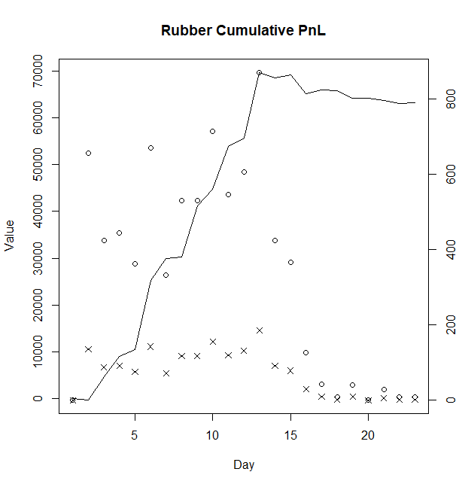
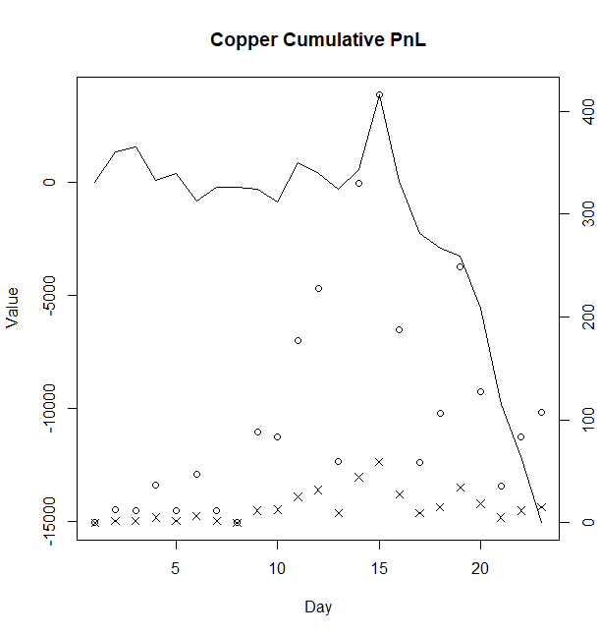
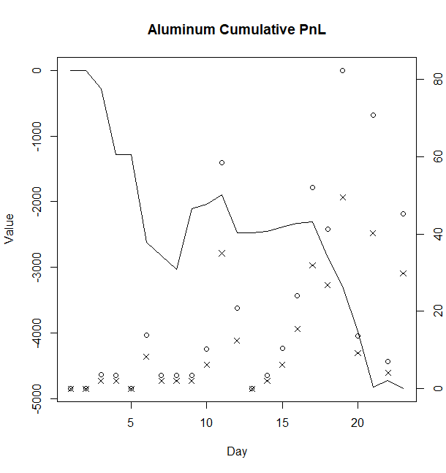
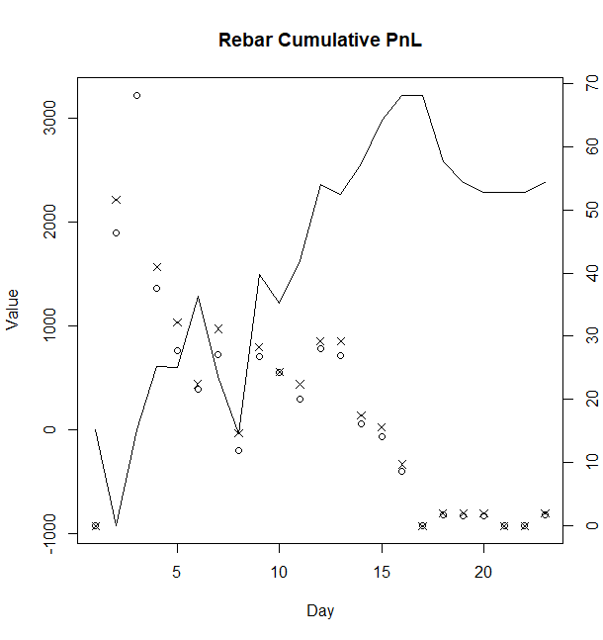
Result of Improved model
○:Trading Cost
×:Number of Trade
-: cumulative profit

Slide 39
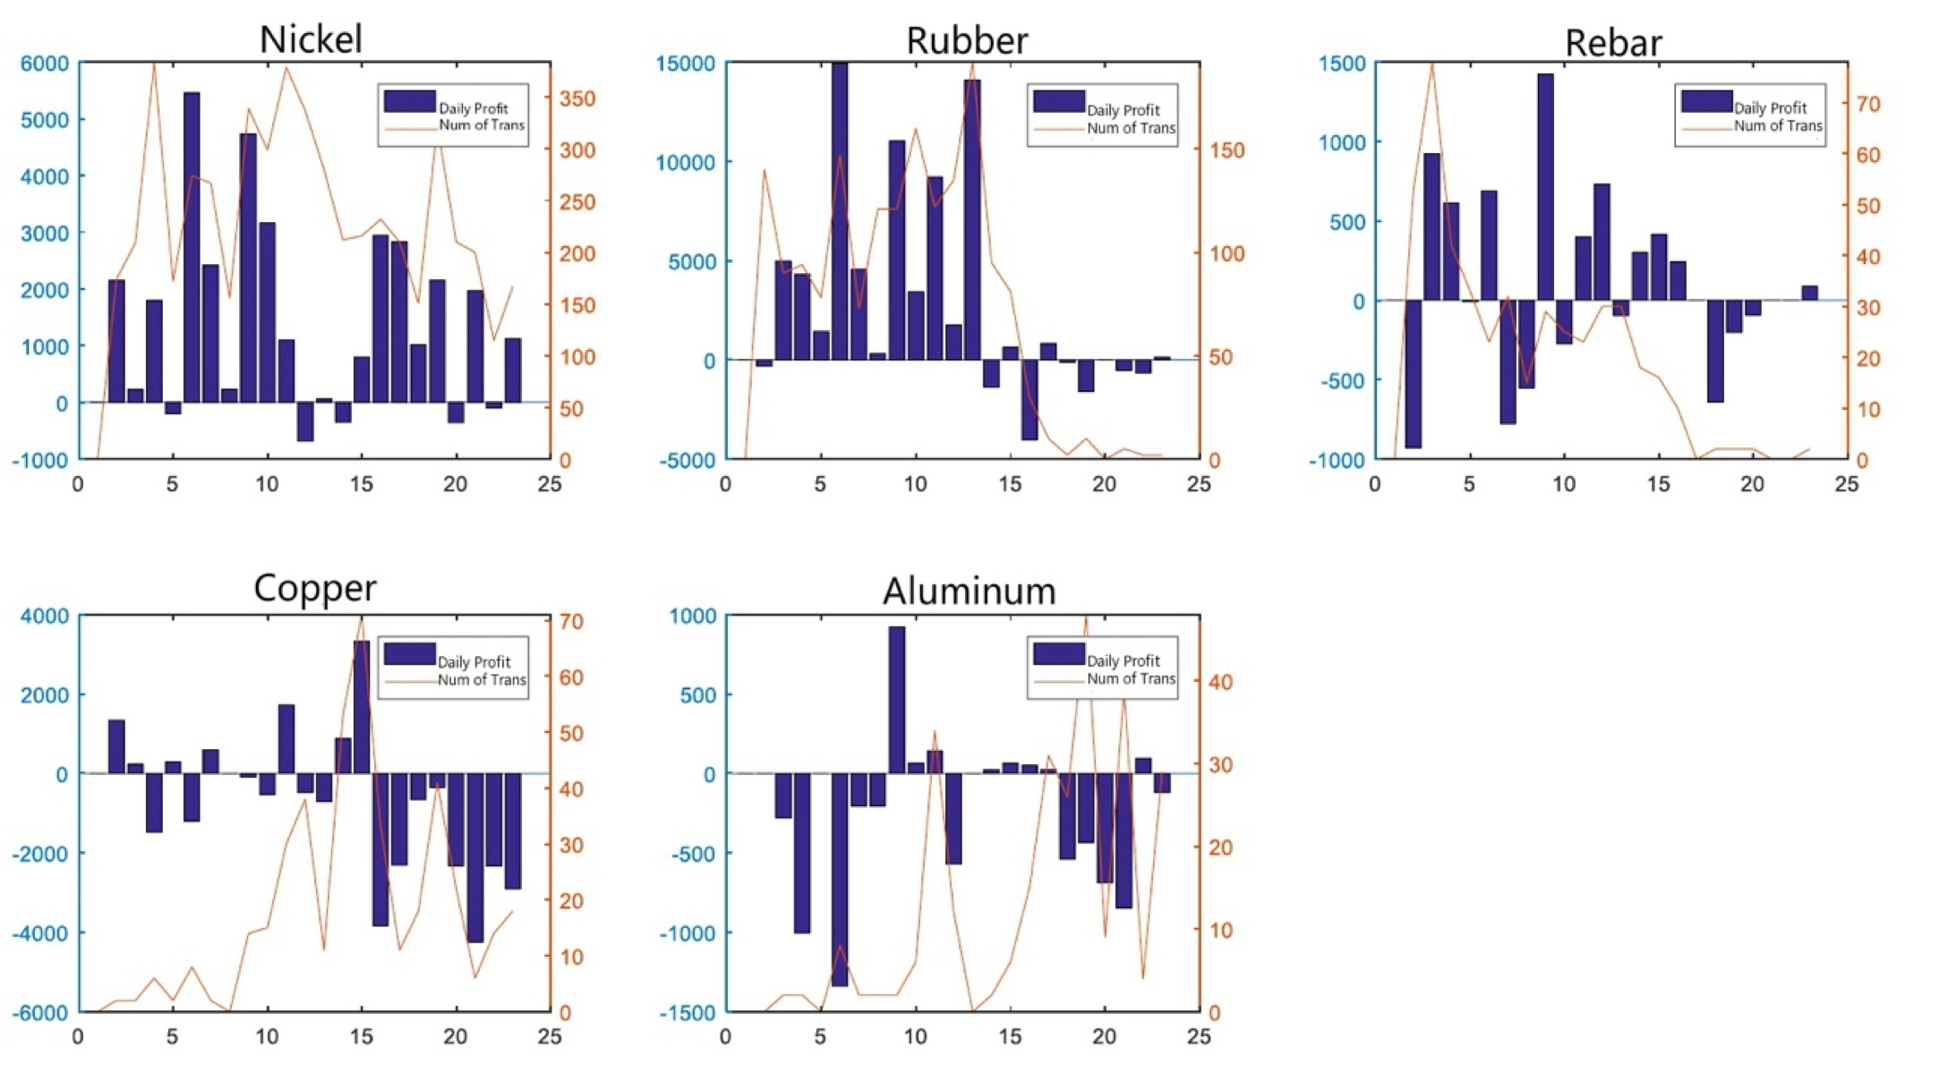
Number of Transactions & Daily Profit
Improved Model
Positive correlation between volatility and number of transactions
Some breeds: strategy inefficient in some days

Slide 40
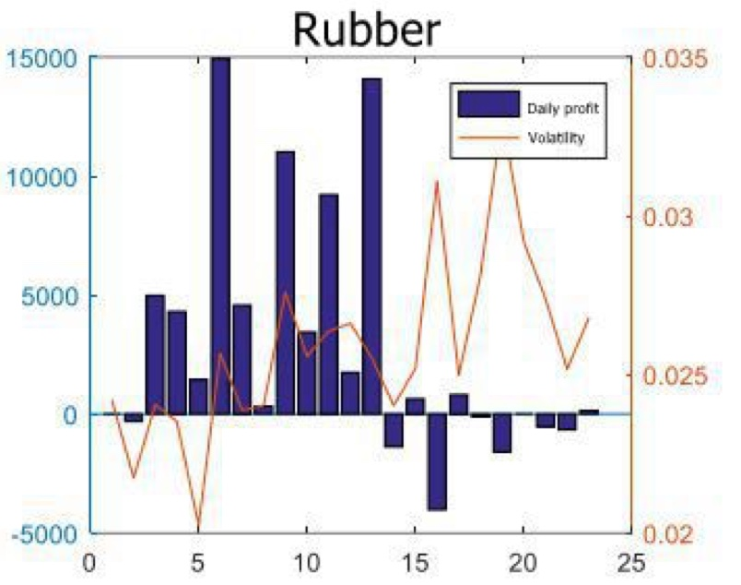
Number of Transactions & Daily Profit

Slide 41
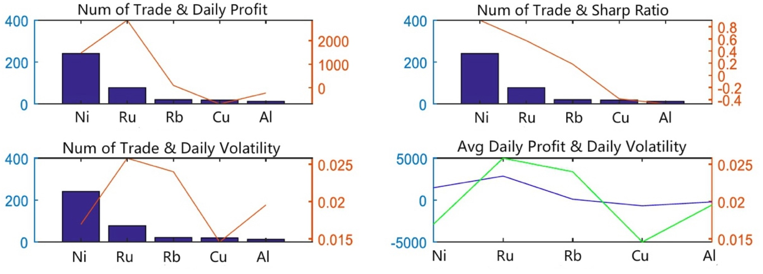
Summary
Number of transactions → difference in daily profit
In general, number of trade correlated with daily profit
Positive correlation between number of trade and Sharpe ratio
Relationship between number of trade & daily volatility
Closely relationship between average daily volatility and daily profit

Slide 42
Summary
Number of transactions → difference in daily profit
In general, number of trade correlated with daily profit
Positive correlation between number of trade and Sharpe ratio
Relationship between number of trade & daily volatility
Closely relationship between average daily volatility and daily profit

Slide 43
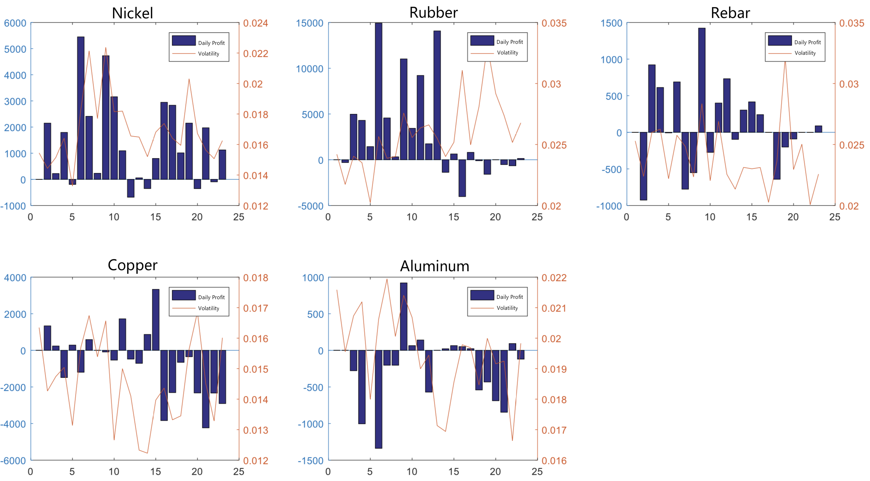
Daily profit & Daily Price Volatility
Daily profit: Ni, Ru > Rb > Cu, Al
Nickel: 17 days of positive profits out of 22 trading days. Daily profits have strong correlation with price volatility.
Rubber: In the first 13 days, our strategy produce significant positive profits. But in the last 9 days, most of the days have negative profits.
Rebar: the profitable days mainly concentrated in the first 16 days. The last several days don’t have profits.
Copper: Worst profits among all five futures. Reduced trading times result in open interests, further leading to reduced losses.
Aluminum: Relationship between price volatility and daily profits is extremely unstable.

Slide 44
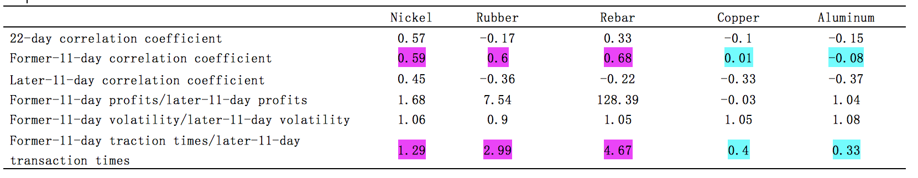
Daily profit & Daily Price Volatility
From these two tables, volatility has a positive correlation with daily profit only when the transaction times are large enough.

Slide 45
Conclusions
We verified that there exists order imbalance in China’s commodity futures market.
Our models can be used to predict future price change. Improved model has higher daily average revenue. Daily average profit of rebar becomes positive after switching to improved model.
Strategy has different effects on various futures varieties. It is more efficient on Nickel and Rubber.
Positive correlation between number of transactions and daily profit. Positive correlation between price volatility and profits.
Our model performs better on the varieties with large price volatilities and large number of transactions.

Slide 46
Future Work
The sample is not large enough. It is better to test on at least one year.
We employed OLS regression, and the R square is not large. Perhaps some nonlinear model can have better results like Logistic regression and Probit regression.
This strategy defines maximum holding between +1 and -1 for controlling variables. To have a better results, we can cancel this limit to explore the optimal position under certain principles (e.g. Kelly formula).

Slide 47
Thank you!

